Slide 1
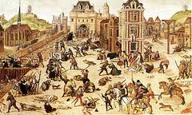
The French Civil Wars, Wars of Religion and Fronde Revolts
1562-1598, 1648-1653

Slide 2
Timeline of the Wars of Religion
First Civil War (April 1562 – March 1563)
Second Civil War (September 1567 – March 1568)
Third Civil War (August 1568 – August 1570)
Fourth Civil War (December 1572 – June 1573)
Fifth Civil War (December 1575 – May 1576)
Sixth Civil War (March 1577 – December 1577)
Seventh Civil War (November 1579 – November 1580)
War of the Three Henrys (March 1585 – August 1589)
Henry IV vs. the Holy League (August 1589 – May 1598)

Slide 3
Causes
Protestant reform goes against “one faith, one law, one king” policy
  Need religion to keep order in state and be unifying factor between citizens
Death of King Henry II in 1559
  nobles saw chance to seize power
  Ultra-Catholic House of Guise gains power
  Threatens power of Montmorency House and Protestant Bourbon House
France wanted to be Catholic, but independent of Pope’s power
  Appointed their own bishops
  Clergy in high positions living in luxury
  Lower clergy lived in poverty

Slide 4
First War (1562-1563)
  Began with Massacre at Vassay of Huguenots by Guise family
    Servants of Duke of Guise got in argument with local Huguenots when travelling and started to shoot them and other civilian
  In Paris, Louis Bourbon, Prince of Condé, asked to be “Protector of the Churches” by Protestants
    Captured cities, waterways, and asked for help from England and German princes.
    Headquartredd in Orleans
  Catherine de Medici turns to Guise family for help
    Gain support from Pope and Phillip II of Spain
  War is mostly sieges and captures of town
  One battle at Saint Dreux: Catholic victory
  Admiral de Coligny led Protestants to safety in Orleans
    Orleans under siege from 1562-1563
  Catherine de Medici had little power
    Made both sides give up noble prisoners and passed Edict of Amboise
    Gave Protestants limited freedom
  Duke de Guise died at Orleans and Antoine of Navarre died at Rouens siege

Slide 5
Second War (1567-1568)
  Began with attempt by Huguenots to capture king : Conspiracy of Meaux
  Catholic forces aided by Spanish troops
  Protestant forces supported by Elector Palatinate of German states
  Conde defeated at Battle of St. Denis in November 1567
    Montemorency killed
  Treaty of Longjumeau in March 1568
Third War (1568-1570)
Cardinal de Lorraine made plans to capture Conde and Coligny
  Conde and Coligny made alliance with William of Orange
Guise family more closely involved with Spain
Fighting in more rural areas than towns
Protestants lost at Jarnac in March 1569
  Conde died
Treaty of Saint Germaine : 1570
  More favorable to Protestants

Slide 6
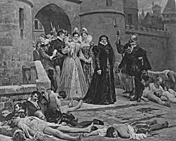
St. Bartholomew's Day Massacre (1572)
Wedding between Margaret of Valois, daughter of Catherine de Medici, and Henry of Navarre, son of Antione of Navarre
  Cardinal of Lorraine planned to murder Admiral Coligny
  Catherine de Medici persuades King Charles IX to strike the Huguenots before Huguenots strike him
  Murder of 10,000 Huguenots all over France
Made toleration almost impossible
Protestant found stronghold in south of France away from Catholics in Paris
  Created almost independent state with own taxes and law courts
  Angered government and Catholics
  Wars started to become political and religious

Slide 7
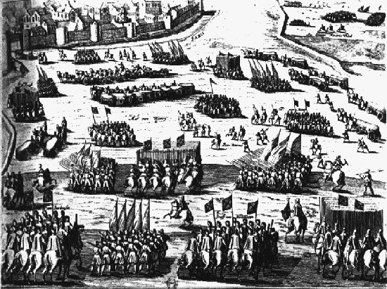
Fourth War (1572-1573)
Main event: Siege of La Rochelle
  Led by Duke of Angou, future King Henry III
La Rochelle was a Protestant city
  Did not want to pay taxes because of Massacre
Februrary 1573: siege ended because of too much financial strain
  Treaty of La Rochelle: almost the same as Treaty of Saint Germaine
  Not favorable to Protestants

Slide 8
Fifth War (1575-1576)
Charles IX died and Henry, duke of Anjou became king
  Henry feared Guise family was too powerful and threatens his throne
Prince de Conde, son of Louis Bourbon, gained money and troops from German princes
Henry of Navarre escaped from La Rochelle in 1576 and raised army
Duke of Alencon, last of Valois sons, tried to convince the people to make him king
Armies march to Paris
Catherine de Medici has to negociate
  Treaty of Monsieur in 1576
  Granted freedoms to Protestants
  Catholics angry

Slide 9
Sixth War (1577)
Guise family and other powerful Catholics form Catholic League in 1577
Henry III lost Catholic support, to regain it, he made himself the head of the Catholic League
Revoked Treaty of Monsieur rights
  Implemented Treaty of Bergerac
  Only allowed to worship in one town in each district
Declared Wars of Religion over
Relative peace from 1577 to 1584
Seventh War (1579-1580)
Also called the Lover’s War
Henry of Navarre seized Chaors
Treaty of Nerac between Henry of Navarre and Catherine de Medici
  Henry of Navarre had control of southwest of France
Duke of Anjou died
  Henry of Navarre heir to French throne as Henry III was childless

Slide 10
War of the Three Henries (1585-1589)
War in proxy between Protestant England and Catholic Spain and Holy Roman Empire
  England supported Huguenots and Henry of Navarre
  Spain and Holy Roman Empire supported Catholics and Henry Duke of Guise
Henry III tries to convince Henry of Navarre to convert to Catholocism
  Henry of Navarre refused and the Pope excommunicated him and the Prince of Conde
  Navarre had to raise army to protect himself
The Guise family revived the Catholic League and signed Treaty with Spain in 1584
  League very powerful in Paris, League of Sixteen ruled over the 16 provinces of France
  Threat to the king
  Henry III lost control in Paris
  Guise march to Paris on the Day of Barricades against Henry III orders

Slide 11
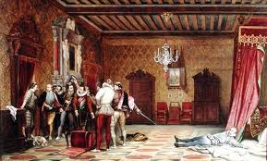
War of the Three Henries (cont.)
King had to flee
1585: Treaty of Nemours: revoked all privileges of Protestants
  Catholic League under Guise dominated north and east
  Navarre had stronghold in southwest
1588: Committee of Sixteen took complete control of Paris
  Proposed heir to throne: Old uncle of Navarre who would act as puppet for Guise
After Estates-General meeting, Henry III had Henry Duke of Guise murdered
  League supported antiroyalists, claimed regicide was necessary
Henry III went to Navarre for help and retook Paris in 1589
  Got stabbed by a monk and named Navarre heir on deathbed

Slide 12
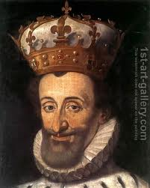
War of the Three Henries (cont.)
Fighting continues between Navarre and League
  Navarre laid siege to Paris
  Phillip II ordered Duke of Parma to help Paris
  No combat, but Navarre withdrew
1593: League calls Estates-General to decide next king
  Henry of Navarre made King Henry IV
  Marries Marie de Medici
  Converts to Catholicism
  “Paris is worth a mass”

Slide 13
Henry IV vs. Spain
1594: Henry IV had control of Paris
Phillip II strongly opposed him
Henry IV gained support of nobles by promising high positions of power
Spanish gained support in northern France and took northern territories from 1595-1596
1598: Spanish had financial problems so they signed the Treaty of Vervins
  Restored captured lands
  Legue leaders surrendered
1598: Edict of Nantes: religious tolerance in France and end of Religious Wars

Slide 14
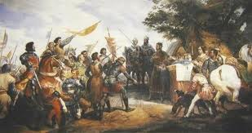
Fronde Revolts (1648-1653)
“sling” =child’s game played to defy authorities
Revolts were reaction to policies made by Cardinal Richelieu, chief minister of Louis XIII
  Less power for nobility
  Reduced power of Parlements
  Beginning of absoolutism
Revolts started under Regent Anne of Austria and chief minister Cardinal Mazarin
  Parlement refused to approve to revenue measures of monarchy
First phase: Fronde of the Parlement
  Wanted constitutional monarchy, listed 27 reforms
Anne and Mazarin were at war and agreed
  Later after winning war, reverted back to old policies
Anne and Mazarin arrested two members of Parlement, but released them after riot in Paris
  Paris blockade could not make Parlement surrender
  Negociated Peace of Rueil and gave Parlement reforms they wanted

Slide 15
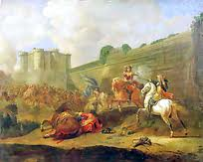
Fronde Revolts (cont.)
Second phase: Fronde of Princes
  Aristocratic rebels did not like Mazarin
The Great Conde helped government against Parlement, did not get political power, and became rebellious
  Was arrested
  Other princes led revolts in provinces but were easily quelled
Conde supporters and Parisian party wanted release of Conde and resignation of Mazarin
  Anne joined Parisian party which made Conde declare war
  Conde entered Paris and had Spain’s support but was almost defeated by royal troops, lost support of Parlement and lost support of bourgeoisie
Conde left Paris and Louis XIV returned with Mazarin
Exiled nobles and took away political power of Parlement
Became absolutist state with no opposition to the king until the revolution

Slide 16
Works Cited
Bernier, Olivier. Louis XIV: A Royal Life. New York: Doubleday, 1987. Print.
Buisseret, David. Henry IV. London: George Allen & Unwin, 1984. Print.
"French Religious Wars: Paris during the League (La Ligue)." SuperStock. N.p., n.d. Web. 17 Dec. 2012.
"French Wars of Religion." 2011-12 AP EURO (A). N.p., n.d. Web. 18 Dec. 2012.
"The French Wars of Religion." Historical Miniatures Wargaming Resource Site: French Wars of Religion. N.p., n.d. Web. 18 Dec. 2012.
Frieda, Leonie. Catherine De Medici: Renaissance Queen of France. New York: HarperCollins, 2003. Print.
"The Fronde." Encyclopedia Britannica. Encyclopedia Britannica, 2011. Web. 17 Dec. 2012. <http://www.britannica.com/EBchecked/topic/220750/the-Fronde>.
Newman, Alex. "The Wars of Religion." Le Poulet Gauche. N.p., 1 Jan. 2004. Web. 17 Dec. 2012. <http://www.lepg.org/wars.htm>.
"Paul Delaroche "The Assassination of Henri De Lorraine (1549-88) Duc De Guise"" Art-Prints-On-Demand.com. N.p., n.d. Web. 18 Dec. 2012.
"Portrait of Henry IV of France." 1st-art-gallery.com. N.p., 2010. Web. 18 Dec. 2012.
Prince Michael of Greece. Louis XIV: The Other Side of the Sun. Trans. Alan Sheridan. New York: Harper & Row, 1983. Print.
Ramani, Jyotsna. "10 Biggest Massacres in Mankind Past !!!" Urban Titan. N.p., n.d. Web. 18 Dec. 2012.
"Religion, Wars of." Infoplease. Pearson Education, 2012. Web. 17 Dec. 2012. <http://www.infoplease.com/encyclopedia/history/religion-wars-of.html>.
"Third French War of Religion." History Learning Site. History Learning Site, n.d. Web. 16 Dec. 2012. <http://www.historylearningsite.co.uk/FWR3.htm>.

Slide 17
The End

